Slide 1
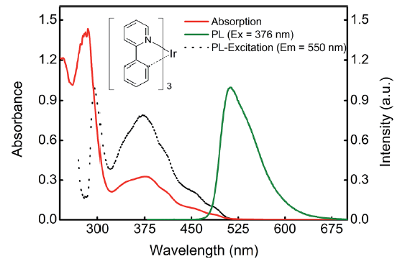
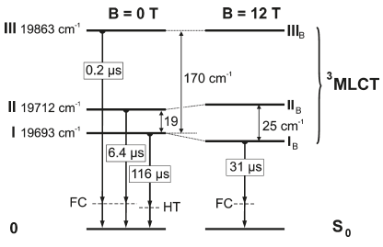
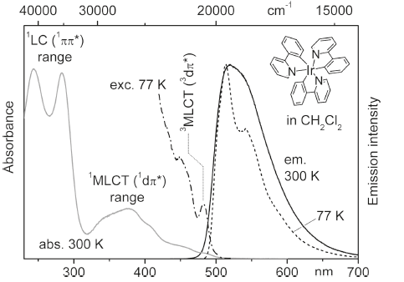
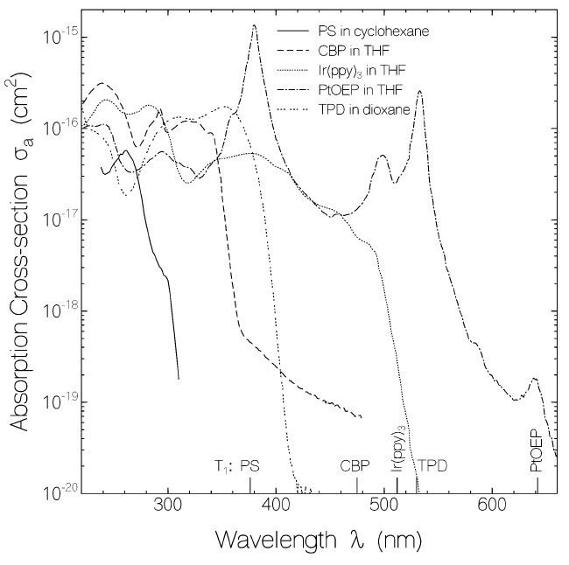
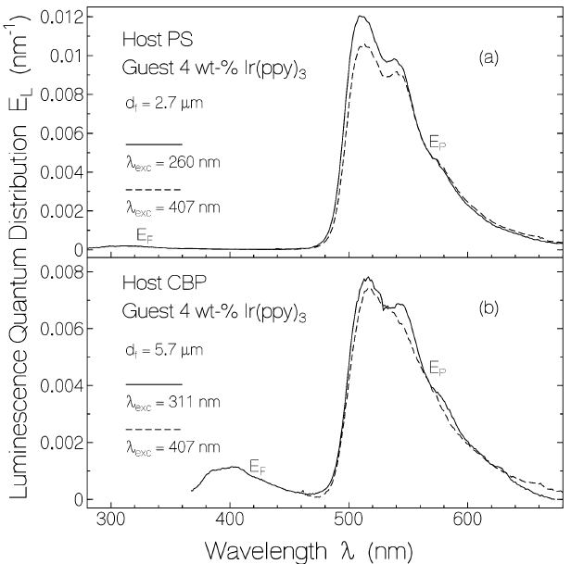
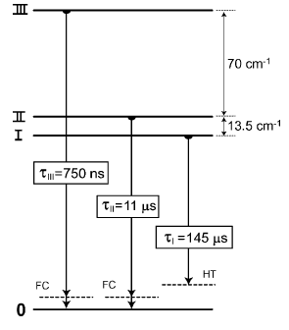
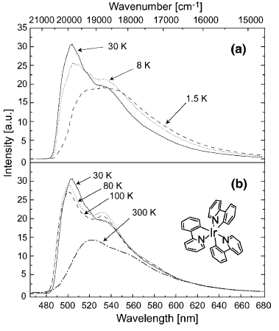
✓ Ir(ppy)₃ ZFS 확인용
Optical Pumping Scheme
2015, Mehata, RSC Advances
2010, Hofbeck, Yersin, Inorg. Chem.
- Pump pulse: 355 nm, pulse energy: 5 mJ
- Generated by the third harmonic of a Nd-YAG laser
- FWHM: 10 ns, Rep. rate: 3 Hz (initially 10 Hz, reduced by chopper)
- Probe light: Xenon flash lamp was used (over 340–620 nm)
- Pulsed Nd:YAG laser (355 nm, pulse half-width < 8 ns)
- or CW diode laser (372 nm)
- site-selective emission and excitation spectra: dye laser
(Scanmate 2C, Lambda Physik)
2007, Bansal, Molecular Crystals and Liquid Crystal
2003, Finkenzeller, Yersin, Chemical Physics Letters
- 200-W high-pressure mercury lamp (311, 365, 407, and 526 nm)
- 450-W xenon lamp (260 nm, FWHM: 30 nm).
- lifetime measurement: Ruby laser (347.15 nm, duration 35 ps)
- Argon laser was used as excitation source.
- Emission decay times measurement: N₂ laser
(337.1 nm, pulse duration of 5 ns)

